Slide 1

Instructional Design Unleashed
Promoting the book in unique way.

Slide 2
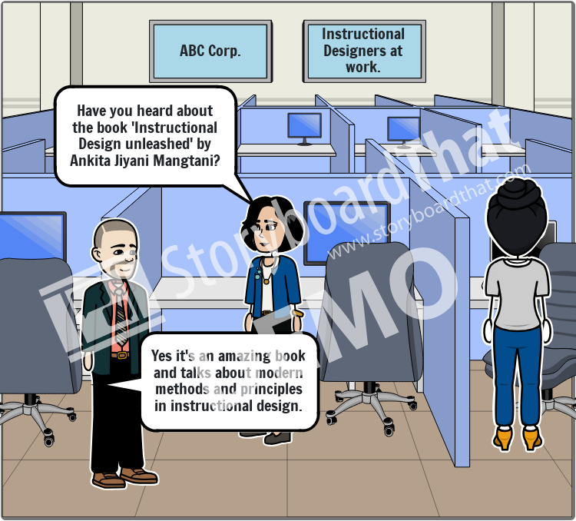
At office
Show two employees talking about the book.
The conversation of the employees given in a speech bubbles.

Slide 3
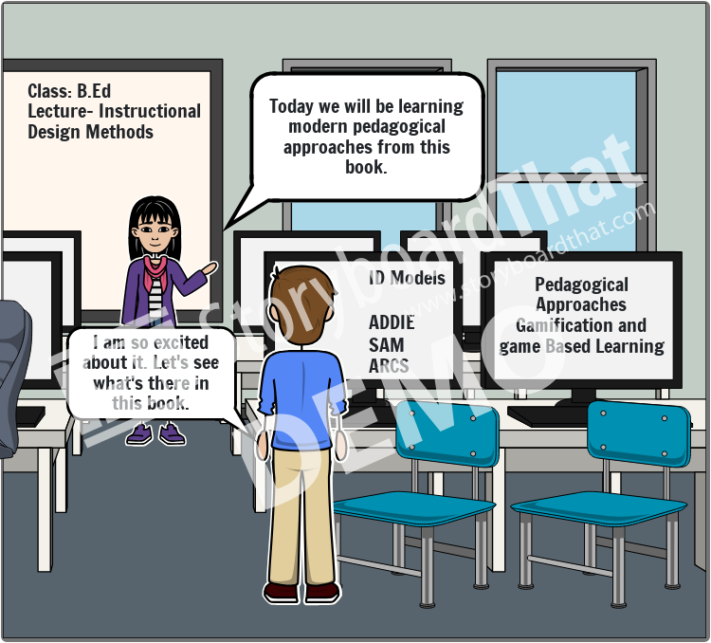
In classroom
Show a classroom with computers and students are working on it.
Show the book “Instructional Design Unleased” in the hands of the teacher.
The conversation between teacher and student given in the speech bubbles.

Slide 4



Online webinar
Show a computer screen with an online webinar, where participants are talking about the book.
Show chat options where participants are discussing about the book.
Chat
Mike: This book sounds perfect for my professional development!
John: I’m ordering it right now!

Slide 5
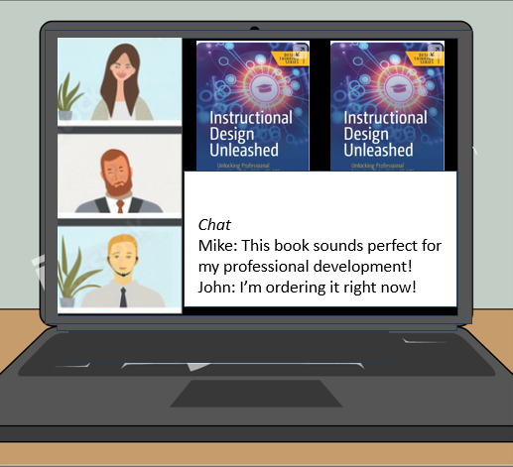

Summarize
Show how the book is applicable to a vast audience and can be helpful for each domain by showing all three scenes together.
Voice Over: Whether you are a research scholar, student, newcomer, or a seasoned instructional designer, this book is for you. Where you can learn practical approaches for creating effective learning experiences.

